Slide 1
Smash Industrial Agriculture for Climate Justice
Free the Soil

Slide 2
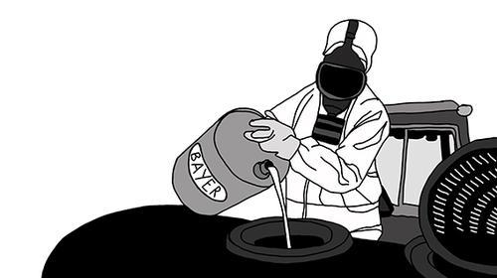
Why do we want to work against industrial agriculture, and why are synthetic fertilizers a good target?
Notes:
It’s time to recognize the major role of industrial agriculture in causing the climate crisis.
The climate justice movement has had great success exposing how the fossil fuel industry is brutally killing the planet for profit, but so far the industrial agricultural system has largely gone under the radar. This booklet will show how agricultural businesses are enforcing false and dangerous solutions to the climate crisis, only to expand their markets and continue their harmful businesses as usual. Let us, individuals and groups fighting for global climate justice, widen the focus of the climate justice movement and dismantle the industrial agricultural system, together!
Why synthetic fertilizers?
The big fertilizer companies, e.g. Yara, Mosaic and PotashCrops, are pretty much the oil companies of the food system. The production of fertilizer is an highly energy intensive process using enormous amounts of fossil gas. The production and usage of synthetic fertilizers alone is estimated to be responsible for up to 10% of global GHG emissions when the reliance on fracked natural gas for fertilizer production and the related destruction of soil due to fertilizser use is taken into account. The big fertilizer companies do their best to make us believe that chemical fertilizers are needed in order to feed the world, when in fact farmers can stop applying chemical fertilisers without reducing yields by adopting agro-ecological practices. To secure and expand their markets, the fertilizer companies need the industrial agriculture system to expand to all parts of the world, and they need all of us to believe, that they are part of the solution for creating sustainable agriculture. We need to take action to expose their devastating practices, and to create space for real solutions to the climate crisis.

Slide 3
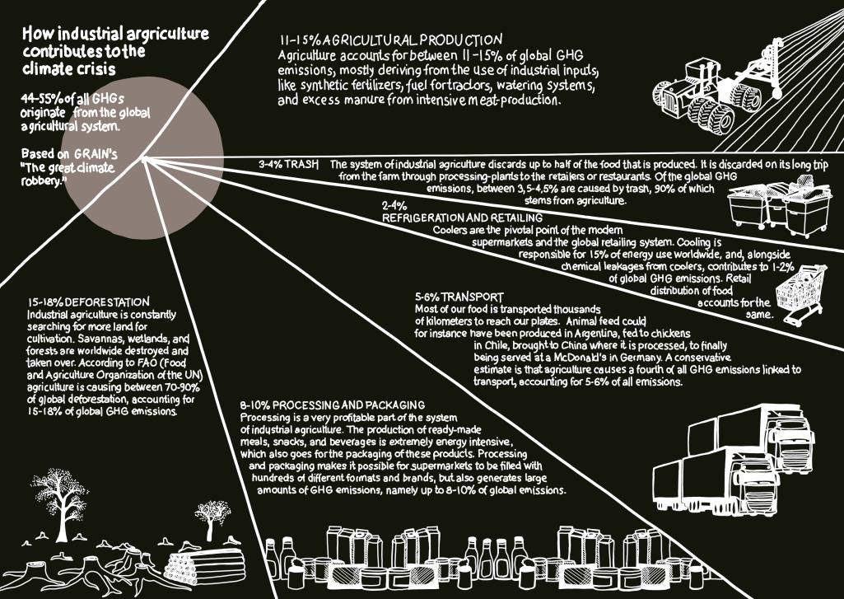
Poster
Notes:
The industrial agricultural system dispossesses small-scale farmers of their land and creates monocultural production on mega-plantations, producing crops for the global market, for bio-fuel, animal feed, and ingredients for processed foods. Industrial agriculture produces without concern for nature, biodiversity, or local food-security, and is one of the main causes of the climate crisis.
It is estimated, that between 44% and 57% of the global greenhouse-gas (GHG) emissions originate from industrial agriculture. The production and use of synthetic fertilizer alone stands for 10% of global GHG emissions, if the industry’s use of gas and its dependence on fracking and land degradation is taken into account. Large fertile areas are destroyed in the search for scarce minerals and cheap gas.

Slide 4
Industrial Agriculture
Specialization
Mechanization
Centralization
Monoculture
Massive use of synthetic fertilizers and pesticides
Notes:
Agriculture as we know it today is a result of the capitalist development of industrial society. Especially in the time after the Second World War, the agricultural methods of the West have become increasingly industrialized.
Industrial agriculture is characterized by:
Specialization:
Industrial agriculture is typically specialized towards one product, for instance dairy- or wheat-production.
Mechanization:
Increasingly large machines and new technology means that only a small amount of labor is required in agricultural production. This also entails the need for large investments in technological equipment.
Centralization:
Farming is concentrated on fewer and larger areas. The land of small-scale farmers is bought and pooled, and as a consequence very few agro-industrial companies own enormous farming grounds.
Immense use of synthetic fertilizer and pesticides:
Traditional farming methods are replaced by production based on the injection of industrially manufactured products, for instance synthetic fertilizers.
Mono-culture:
Typically, only one crop is being grown on large areas. Production of especially exportable crops for animal feed, bio-fuel, and base-ingredients for processed foods, are being prioritized. Globally soy, corn, rapeseed, wheat, sugarcane, rice, and palm oil are increasingly produced at the expense of local food security and biodiversity.
Global data show that small farmers are more efficient than big plantations at producing food. According to FAO, 80% of the world’s food is produced by small farmers – who occupy less than a quarter of the farmlands.

Slide 5
Industrial Agriculture
Food security
Green Revolution
Climate (Corporate) Smart Agriculture
Sustainable intensification
Climate compatible agricultural growth
Notes:
These are terms often used by the industry to promote the expansion to markets in the global south.
Green Revo: plant breeding, application of synthetic fertilizer, rise in productivity
CSA: Yara, Mosaic, Kellog’s, Monsanto
These are the ”false solutions” they promote and the global consensus accept their story
It is this industry we find has gone under the radar for too long

Slide 6
Intersectionality
Food – Land use
Counter neo-imperialism/neo-colonialism
Class
Gender
Probably other..
Notes:
Targeting the issue of food, agriculture and climate we see many intersections that we wish will be embedded in our campaign work
Issues of acces to land and food relates very closely to class struggles. Many movements globally has arrised as the price on stable food has gone up. EG corn Mexico NAFTA.
Women and gender minorities are often dubble oppressed and suffer from land and water grabs, aswell as stay in the areas most exposed to consecuences of climate change
Industrial Agriculture has a neo-colonial nature as described in previous slide, not respecting the knowledge and practice of those who hold the solution – small scale farmers

Slide 7
Why Synthetic Fertilizers?
Key element in industrial agriculture
Production and use of fertilizer + soil depletion = 10% global GHG emmissions
1-2% of global energy consumption
A few large industries dominate the market
Target large industries, not individual farmers
Companies are key players in greenwashing industrial agriculture
So far an unchallenged industry
Notes:
We need to stop the devastating practices of the industrial agricultural system and the few companies that control it. We already know what the solutions look like: agroecology, sustainable farming practices and food sovereignty, which secure self-determination over the food systems.
Let’s smash industrial agriculture for climate justice! Let's educate ourselves, share our knowledge, create networks of resistance, take direct action, and hit the producers where it hurts the most.

Slide 8
Synthetic fertilizers
Nitrogen
Phosphorus
Kalium (Potassium)
Notes:
P+K are minirals, extracted by mining. Non renewable ressources.
Phosphorus: Scarce/Finite ressource - within this century all P will have been used if the current use of synthetic fertilizers will continue
N is produced in chemical process – next slide explains

Slide 9
Nitrogen fertilizers
Energy intensive
The Haber-Bosch method
Directly linked to fossil gas

Slide 10
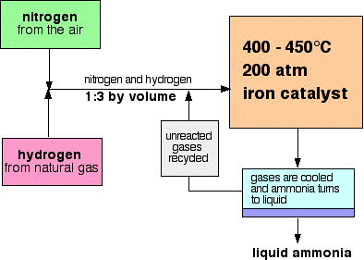
Nitrogen Fixation by the Haber-Bosch process
3O2+2N2+3CH4 → 4NH3+3CO2
Notes:
Source: https://www.chemguide.co.uk/physical/equilibria/haber.html

Slide 11
Haber-Bosch process – a climate villain
The Haber Bosch process requires both large amounts of energy and methane to convert nitrogen from the air into chemical fertilizers: three parts methane to two parts nitrogen.
The production of chemical fertilizers increasingly relies on shale gas from fracked wells, which leak 50% more methane than conventional fossil gas wells. (Methane is 25 times more potent than CO₂ as a greenhouse gas.)
Notes:
Nitrogen fixation depends on gas. An increasing part of the gas is extracted by hydraulic fracturing.
Source: https://www.grain.org/article/entries/5270-the-exxons-of-agriculture Mark Fischetti,”Fracking would emit large quantities of greenhouse
gases,”, Scientific American, January 2012: http://www.scientificamerican.
com/article/fracking-would-emit-methane/
this production will increasingly rely
on natural gas from fracked wells, which leak 40 to 60
percent more methane than conventional natural gas
wells. (Methane is 25 times more potent than CO2 as a
greenhouse gas.)6

Slide 12
Fracking
”People associate Shell, not Yara, with fracking. But it is Yara that coordinates the corporate lobby for shale gas development in Europe, and it is Yara and other fertiliser companies that suck up most of the natural gas produced by the fracking boom in the US” - GRAIN
Notes:
Source: https://www.grain.org/article/entries/5270-the-exxons-of-agriculture

Slide 13
Synthetic fertilizers in the soil
Adding synthetic fertilizers disrupts the natural chemical balance, leading to depletion of soil carbon
This imbalance also kills the naturally occuring nitrogen fixing organisms, along with other soil organisms
This causes a need to continuously apply synthetic fertilizers to sustain crop productivity levels, a viscious cycle

Slide 14
Synthetic fertilizer links to meat industry and land use issue
Fertilizers used on feed and flex (food, feed, fuel) crops
Especially in Northern Europe much of the crops are used in animal/meat industry
Notes:
In (northern) Europe meat industry is dominating agriculture
Land is used for feed for animal production
Much of this animal fodder is grown with large amount of fertililzers

Slide 15
Green revolutions = Neocolonialism
So-called Green Revolutions in the
Global South:
Fossil gas exploration and extraction brings
new market for fertilizer production
Fertilizer subsidy programs imposed to
subsidize farmers
Soil depletion, becomes more fragile
to climate change
Notes:
Sources:
P. 42, https://acbio.org.za/wp-content/uploads/2014/12/Fertilizer-report-201409151.pdf ”While Africa accounts for less than 1.6%
of global fertilizer consumption, huge natural
gas deposits, a key ingredient in fertilizer production, have been found across the continent. Numerous multinational mining
houses are also prospecting for other mineral reserves vital to fertilizer production. As a result, a spate of new fertilizer plants are being planned across the continent. Fertilizers
are a fundamental ingredient of the Green Revolution model of agriculture, which is being pushed onto Africa.”
”Crucially, the imposition of fertiliser subsidies has
Diverted precious resources away from esearch Into crop and soil science which could help to promote the use of less expensive, locally available sources of soil nutrients.”

Slide 16
Farmer Input Subsidy Program
FISP = an development aid funded program to subside the use of synthetic fertilizers in small-scale agriculture.
In Malawi the program was declared a success and is now repeated in many ”south” countries.
”They come with one size fits all policies that just dump GMOs, fertilisers and commercial seeds onto farmers. They use the input subsidy programmes to camouflage the interests and profits of multinational corporations whose products are distributed through the FISPs”.
- Rural Women's Assembly, Malawi
Notes:
MARIA
Sources:
https://ruralwomensassembly.wordpress.com/2017/08/21/rural-women-speak-out-against-food-input-subsidy-programme-in-the-sadc-region/ https://ruralwomensassembly.wordpress.com/2017/09/06/corporate-capture-of-seed-subsidy-programme/
https://acbio.org.za/wp-content/uploads/2014/12/Fertilizer-report-201409151.pdf
http://www.acbio.org.za/sites/default/files/documents/Tanzania-report.pdf

Slide 17
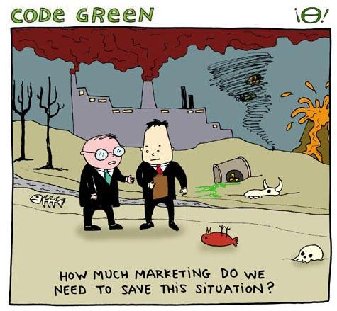
Masters in green washing

Slide 18
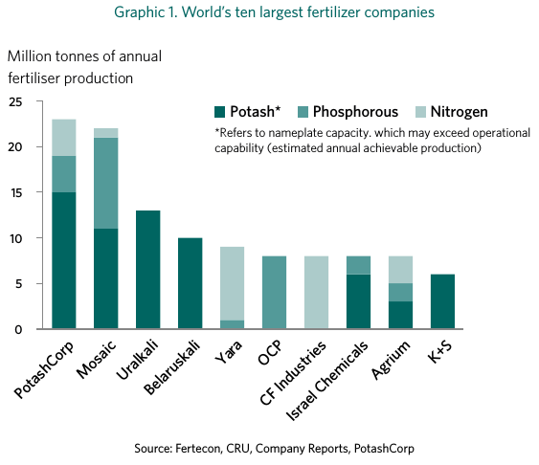
The face of an industry
Data, ano 2015
Notes:
Source: https://www.grain.org/article/entries/5270-the-exxons-of-agriculture
These are the ten largest – and we don't know there names. We don't know their logos.
Free the soil wants to change that.
The only of the ten based in Europe is Yara – let's have a look at them.

Slide 19
YARA – a fertilizer giant
Revenues 2017: NOK 93.8 billion / EUR 9,8 billion
Fertilizer primary activity (27.1 million tonnes fertilizer sales in 2017 of 36.3 million tonnes in total Deliveries)
Yara dominates global nitrogen fertilizer production
Notes:
Sources:
https://www.yara.com/this-is-yara/yara-at-a-glance/
https://www.grain.org/article/entries/5270-the-exxons-of-agriculture

Slide 20
YARA – a fertilizer giant
Established as Norsk Hydro in 1905, demerged as Yara International ASA in 2004
Listed on the Oslo Stock Exchange. Norwegian government owns more than a third of Yara and is its largest shareholder
Headquartered in Oslo, Norway
President and CEO, Svein Tore Holsether, since Sept. 2015
Production sites on six continents, operations in more than 50 countries and sales to about 150 countries
More than16,000 employees
Notes:
Sources:
https://www.yara.com/this-is-yara/yara-at-a-glance/
https://www.yara.com/siteassets/investors/057-reports-and-presentations/annual-reports/2017/yara-international-key-figures-2017-web.pdf/
https://en.wikipedia.org/wiki/Yara_International

Slide 21
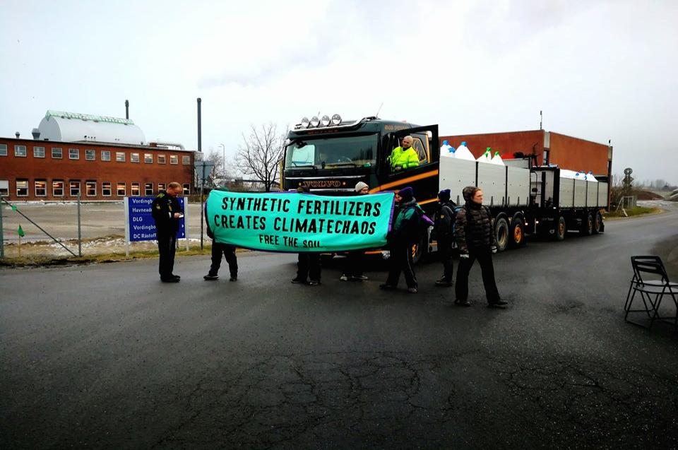
FREE THE SOIL
Notes:
Activities so far
Flyers + booklet
Action at a YARA packing and storage facility in Denmark
Mobilization

Slide 22
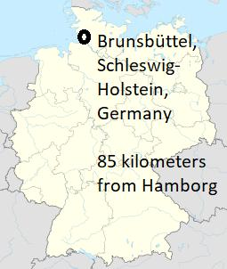
Site: YARA Brunsbüttel
A few maps and images

Slide 23
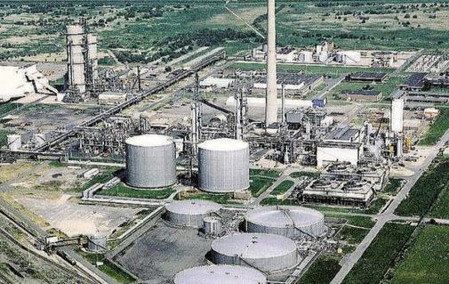
Site: YARA Brunsbüttel

Slide 24
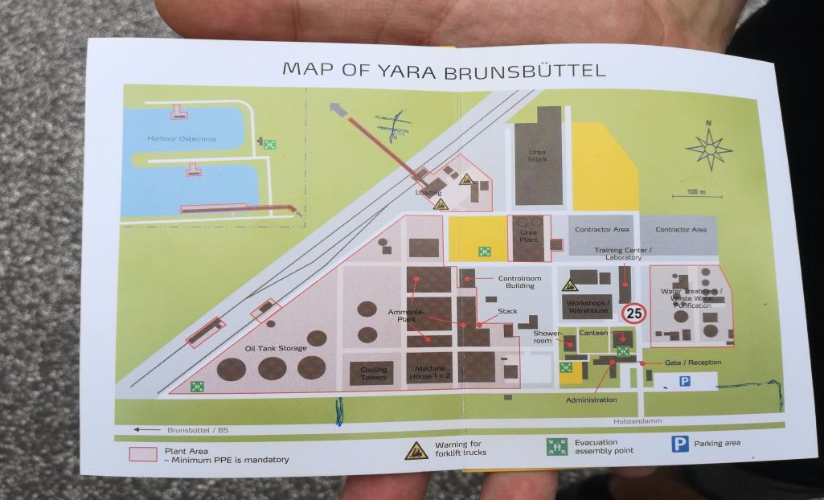
Site: YARA Brunsbüttel
Notes:
Global Alliance for Climate Smart Agriculture (GACSA)
Lobby for Climate Smart Agriculture (CSA) and so-called green revolutions
Sustainable intensifacion
Climate compatible agricultural growth

Slide 25
Let's smash industrial agriculture for climate justice
Join the camp+mass action on the third week of September 2019
Join next Free the Soil plenary in Berlin, Januar 18-20, 2019
Or make your self ready by informing your self and preparing decentralized actions!
Notes:
Direct action
Affinity group based
Queer feminist foundation
Connecting struggles throughout the climate justice movement
Freethesoil.org

